Slide 1


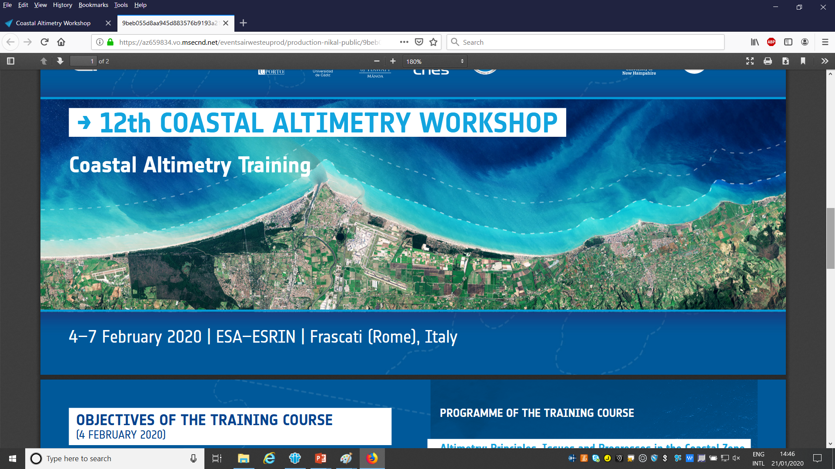





















Advanced Altimetry
M. Restano (SERCO/ESRIN), J. Benveniste (ESA-ESRIN)
February 2018

Slide 2
Limitations of LRM Altimetry

Slide 3
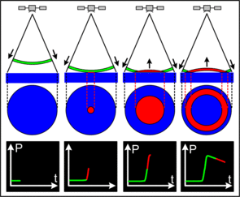
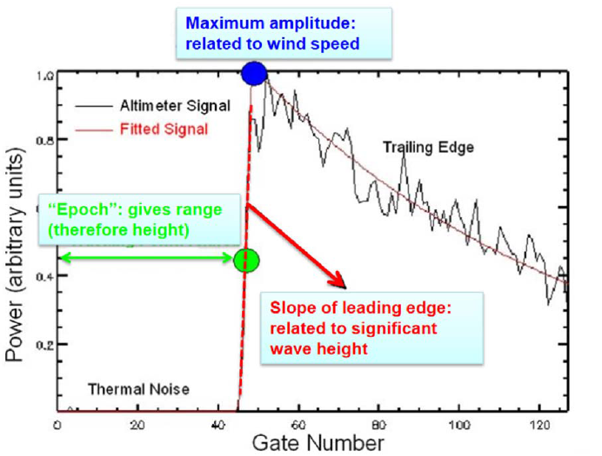
Limitations of LRM Altimetry
LRM altimeters use returns from the pulse-limited footprint (forming the leading edge) to estimate the minimum radar range at nadir.

Slide 4

Limitations of LRM Altimetry
By looking at the trailing edge, it is clear that echoes from scatterers located outside the pulse-limited footprint appear at a relative greater delay:
Power is wasted in receiving echoes that cannot be used for range estimation.
Disadvantages:
Power wasted
Increase in footprint dimension (2-7 Km) as SWH $≫$
Raney R.K. (1998) The Delay/Doppler Radar Altimeter, IEEE T Geosci Remote, Vol. 36(5). https://doi.org/10.1109/36.718861

Slide 5
Delay-Doppler SAR

Slide 6
Delay/Doppler Processing
Starting from these limitations, the Delay/Doppler processing (Raney 1998) aims at:
1) better exploiting the transmitted energy by using the entire beam-limited along-track signal history (leading + trailing edge) instead of only the small pulse limited footprint (leading edge);
2) using the Doppler selectivity to decrease the extension of the footprint in along-track limiting also the influence of an increasing SWH.
Raney R.K. (1998) The Delay/Doppler Radar Altimeter, IEEE T Geosci Remote, Vol. 36(5). https://doi.org/10.1109/36.718861

Slide 7
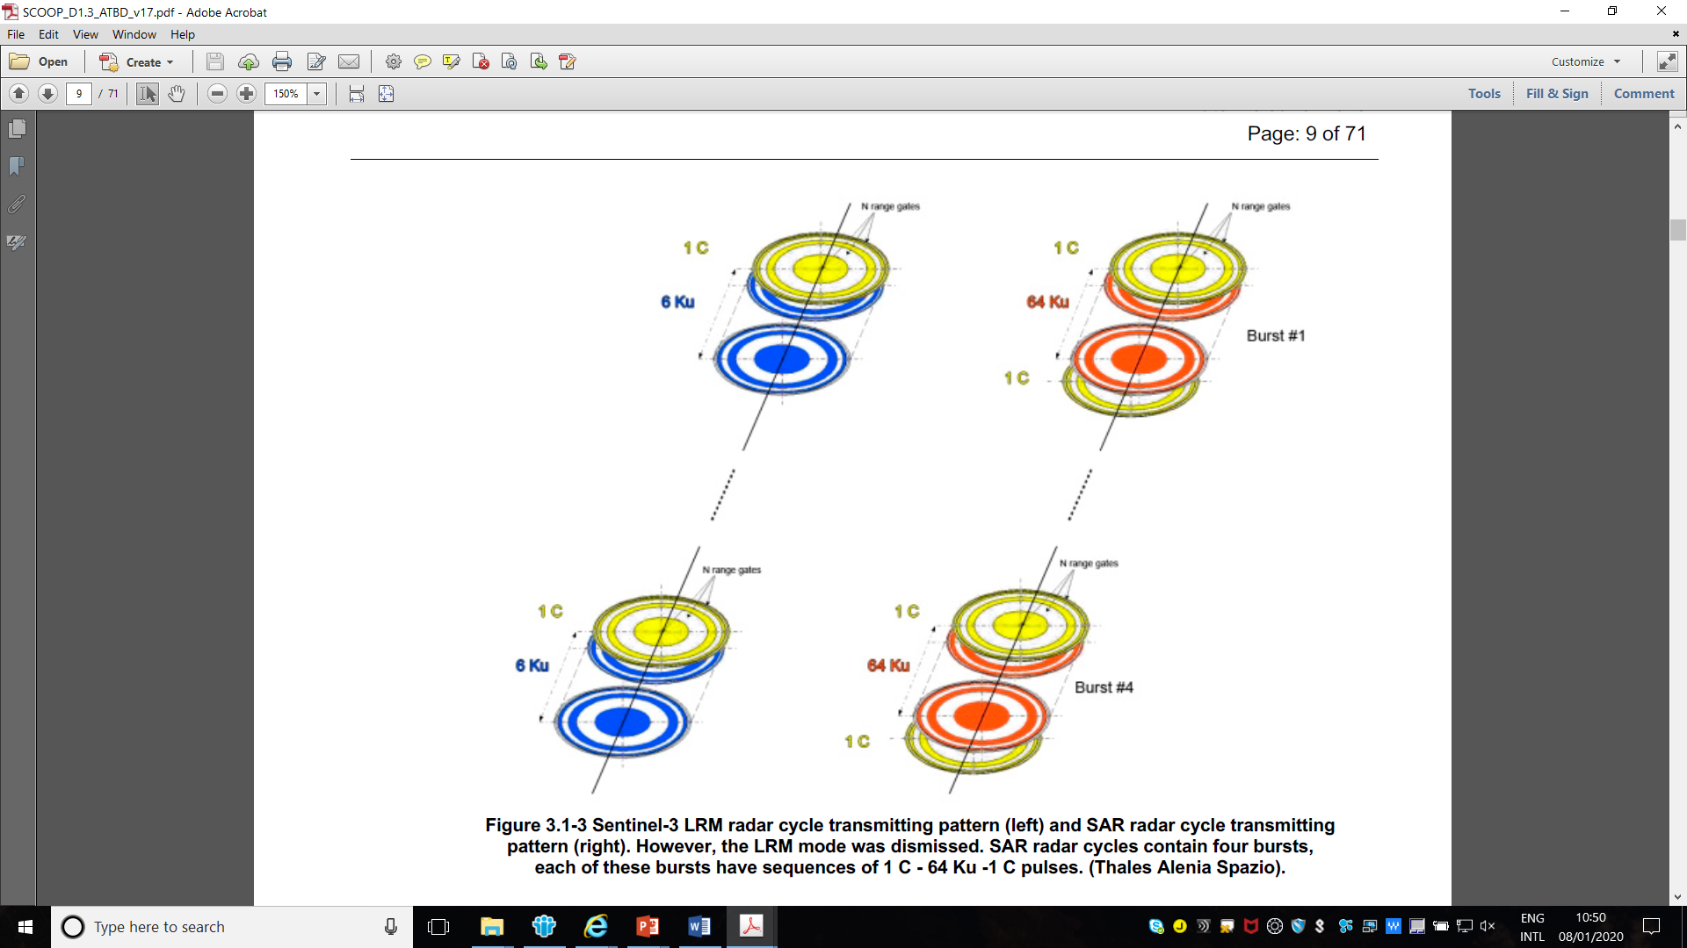
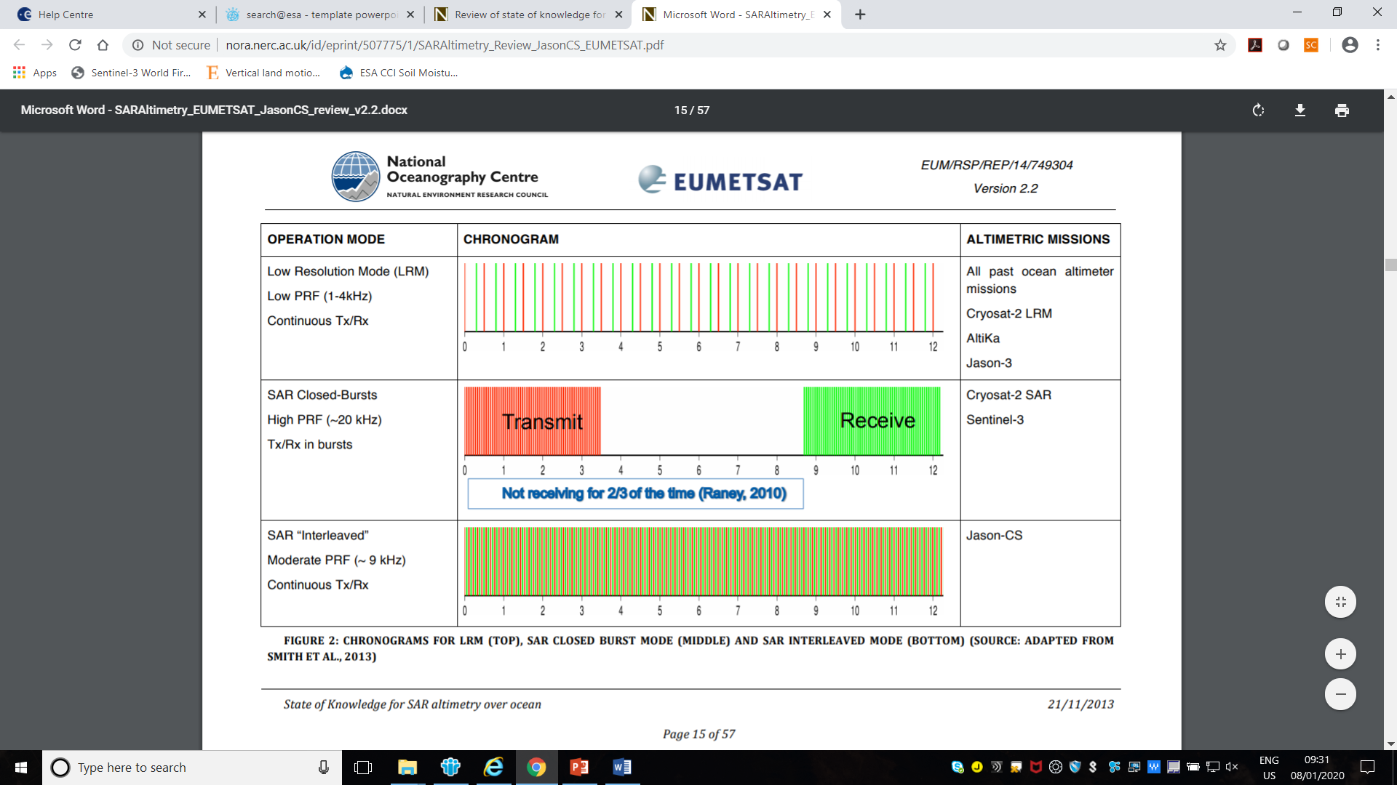
Closed Burst transmission mode
Closed burst: groups of transmitted pulses (bursts) and their corresponding received backscattered signals are at disjoint (non-over-lapping) time windows.
Gommenginger C, Martin-Puig C, Amarouche L, Raney RK (2013) Review of State of Knowledge for SAR Altimetry over Ocean. Report of the Eumetsat Jason-CS SAR Mode Error Budget Study. Southampton, National Oceanography Centre, 57pp. (Eumetsat Reference Eum/Rsp/Rep/14/749304, Version 2.2) http://nora.nerc.ac.uk/507775/

Slide 8
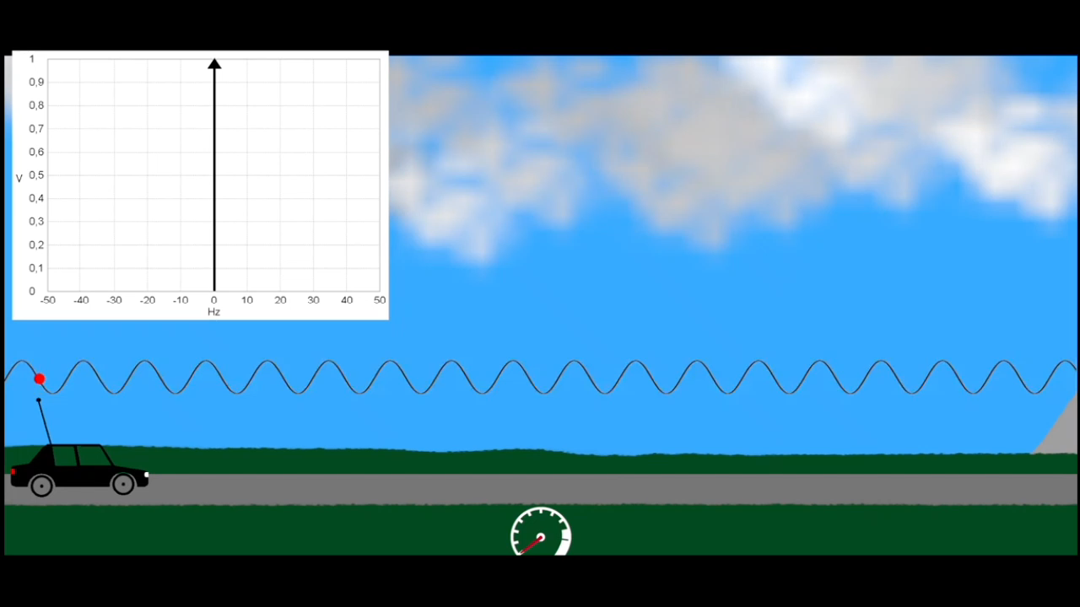
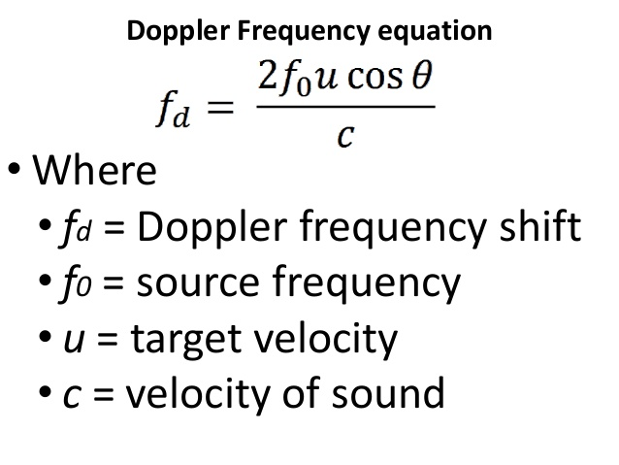
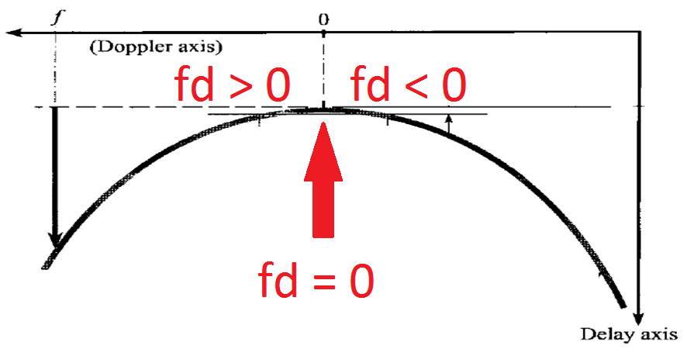
Doppler Effect
Observed Doppler frequency shift:
The Doppler shift is null when the scatterer are in the same along track position, as no relative movement exists.
Video: Prof. E. Riederer / YouTube

Slide 9
Doppler Effect & Radar Altimetry
A Doppler shift is present in overflying a point (1) or, equivalently,
during the acquisition of returns from several surface points located inside the antenna beam in different along-track positions (2).
The Doppler processing allows to transform the 64 pulses in 64 beams for each burst transmission (2).
Once the surface locations are identified, beams from successive bursts are steered to surface locations and accumulated in stacks (1).
2
1
Credit: ESA SCOOP Project

Slide 10
LRM vs delay-Doppler for one burst (Pulse limited vs Beam limited)
Looks allow to partition & control the energy of the area illuminated by the entire antenna pattern (leading + trailing edge)

Slide 11
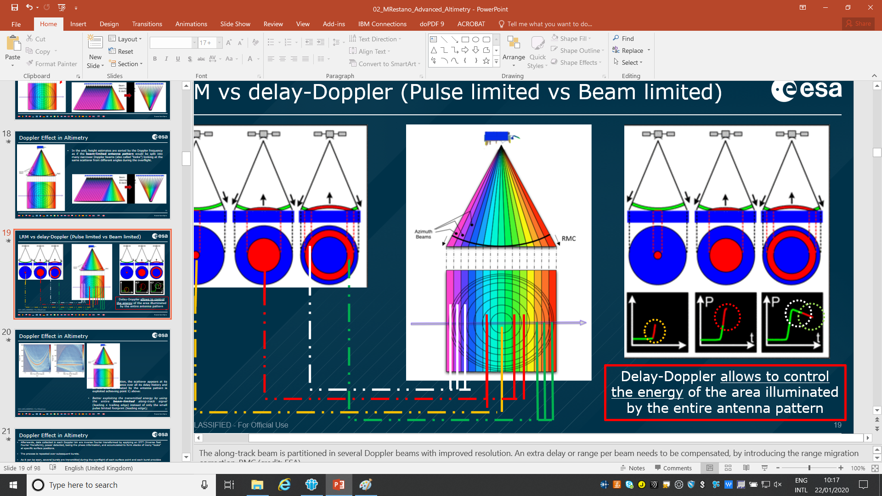
Stacking by the signal point of view
Several bursts are transmitted during the overflight of each surface point and each burst provides one single look (i.e. a portion of the antenna pattern) to a surface point.
(Credit: ESA & isardSAT)

Slide 12
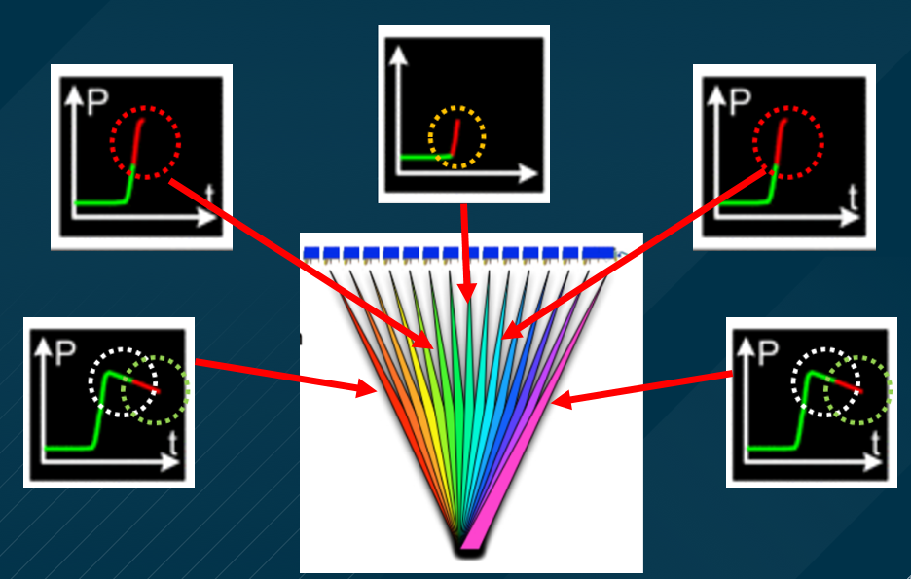
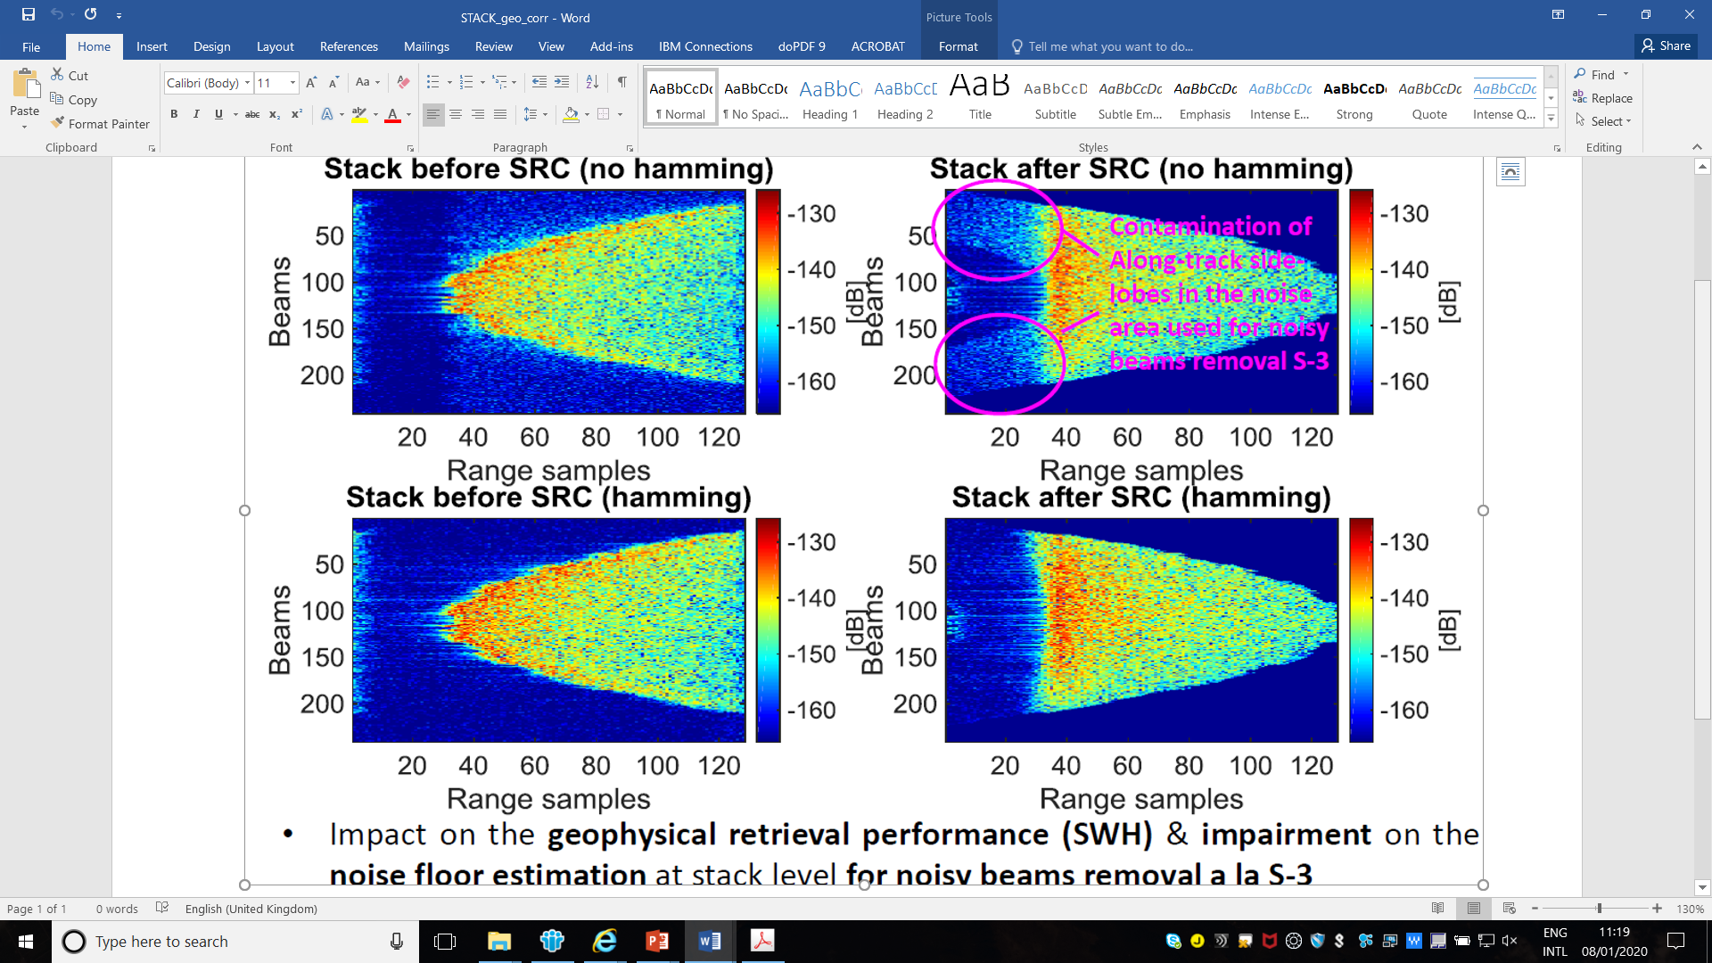
Delay-Doppler Map
Credit: ESA SCOOP Project

Slide 13
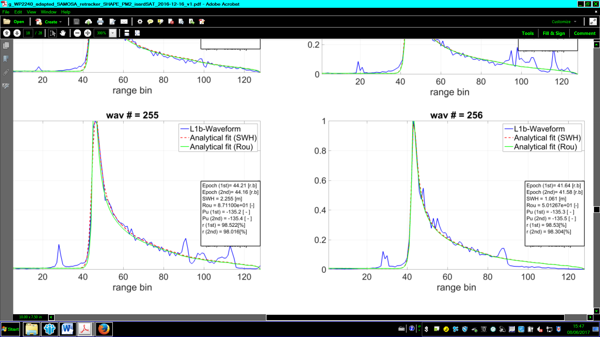
From Delay-Doppler Maps to L1b waveform
The so-called SAR L1b waveform results from the incoherent averaging (∑, see figure) of waveforms (looks=beams) composing the delay-corrected stack that points, typically, the surface location observed by the nadir beam (i.e. beam ~100 in the leftmost figure below).
Up to ~220 looks can be averaged (the speckle noise is reduce by the incoherent averaging, the more looks the more the noise reduction).
SAR retracking is then applied.
Power is normalized after incoherent averaging (∑)
Cryosat-2 Stack of ~220 beams before (left) and after delay correction (right)
∑
Credit: ESA SCOOP & SHAPE Projects

Slide 14
L1b Waveforms SAR vs LRM -> Improvements
In comparison to LRM, the energy in the trailing edge from subsequent delay-corrected burst acquisitions is not wasted but focused (relocated) at nadir, increasing the S/N of the leading edge
Single observation
Up to 220 burst observions /looks needed + Doppler Processing
to relocate power contributions
Along-Track Resolution comparison:
LRM: 2-7 km (SWH-dependent)
Delay-Doppler (SAR): 300 m (Doppler-resolution dependent & SWH-independent)

Slide 15
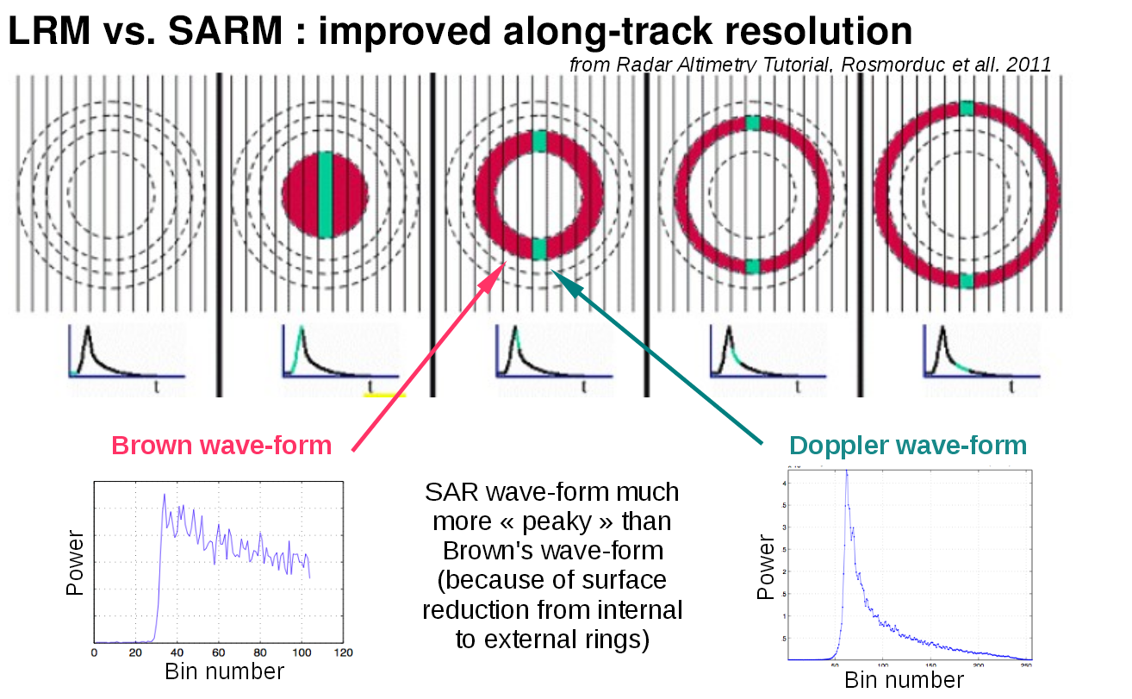
Improve along track resolution

Slide 16
Pseudo Low Resolution Mode (pLRM, RDSAR)
During every 20-Hz radar cycle, CryoSat-2 and Sentinel-3 produce 4 bursts.
Pseudo LRM waveforms derived from 4 SAR bursts (=20Hz, 50 ms).
The RDSAR processing allows to produce data which are not statistically equivalent to LRM data (see chronograms, data are missing for SAR).
Credit: ESA SCOOP Project

Slide 17
The Fully-Focused SAR

Slide 18
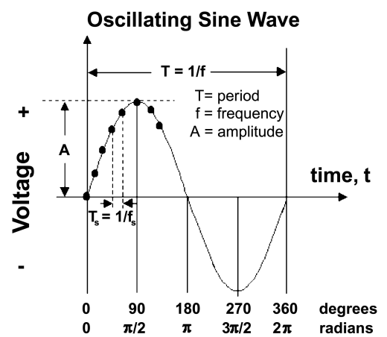
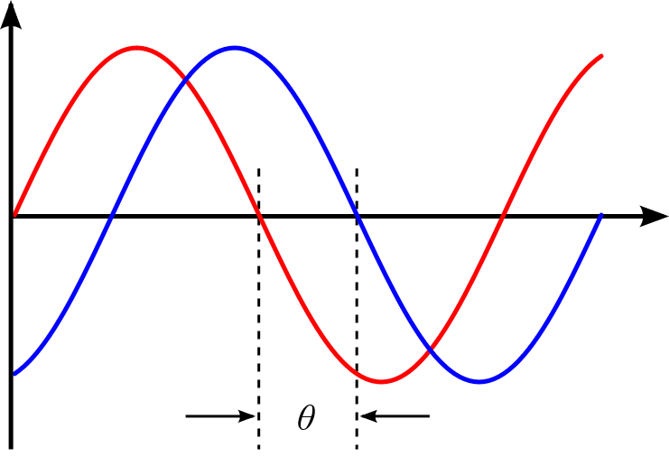
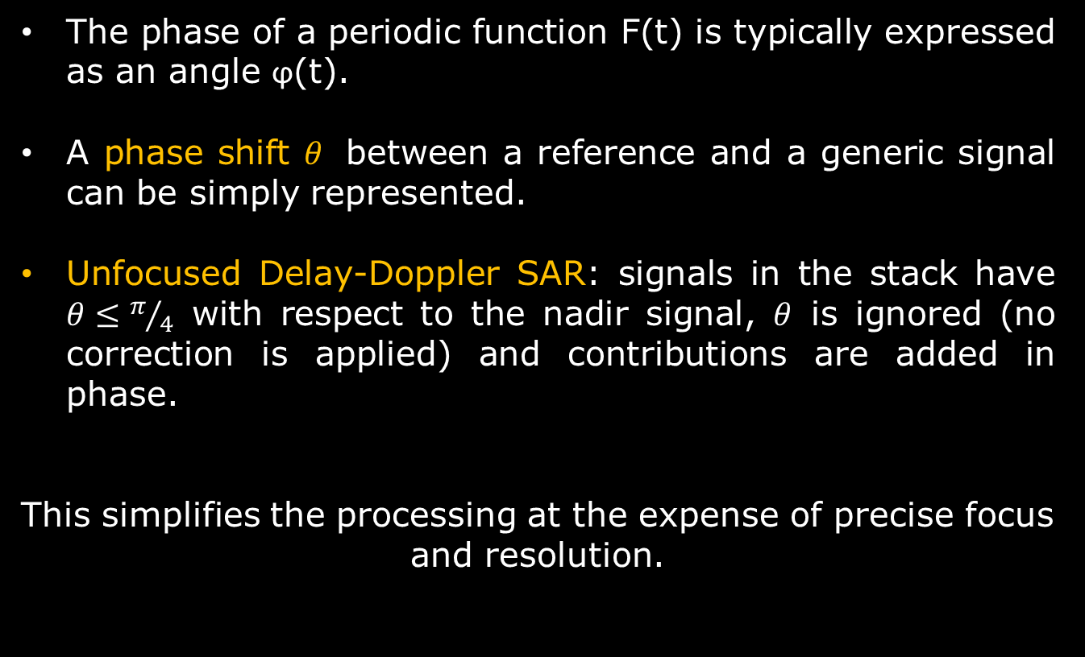
Phase of a signal
The phase of a periodic function F(t) is typically expressed as an angle ϕ(t).
A phase shift $θ$ between a reference and a generic signal can be simply represented.
Unfocused Delay-Doppler SAR: signals in the stack have $θ≤π/4$ with respect to the nadir signal, $θ$ is ignored (no correction is applied) and contributions are added in phase.
This simplifies the processing at the expense of precise focus and resolution.
Credit: wikipedia

Slide 19
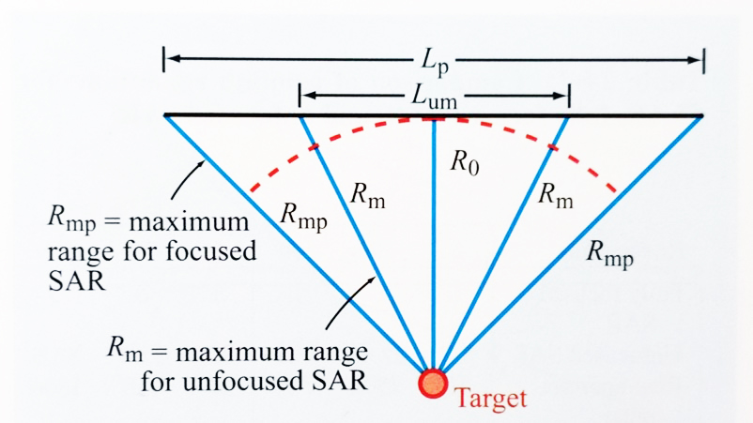
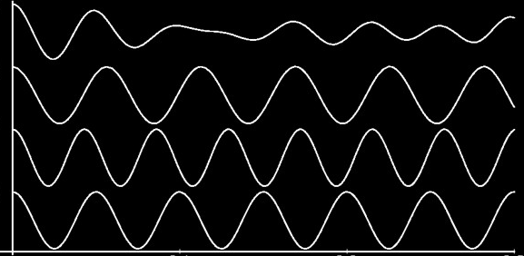

Unfocused vs Focused SAR – Illumination time
Out-of-phase signals (outside Lum)
∑
Phase error is $θ≤π/4$ for the $L_{UM}$region (Unfocused SAR).
A phase error $θ>π/4$ leads to a decorrelation of signals jeopardizing the multi-looking in the Delay-Doppler processing -> FF-SAR processing is needed to exploit the entire Lp region.
Credit: Ulaby & Long (2014), ESA wikipedia

Slide 20
The Role of Phase in the design of coherent radar systems
Whether a radar is coherent or non-coherent always depends on the transmitter.
Non-coherent radar processing: every pulse starts with a random phase
Coherent radar processing: every pulse starts with the same phase
The most important benefit of the Coherent radar is the ability to differentiate small differences in phase.
Credit: wikipedia

Slide 21
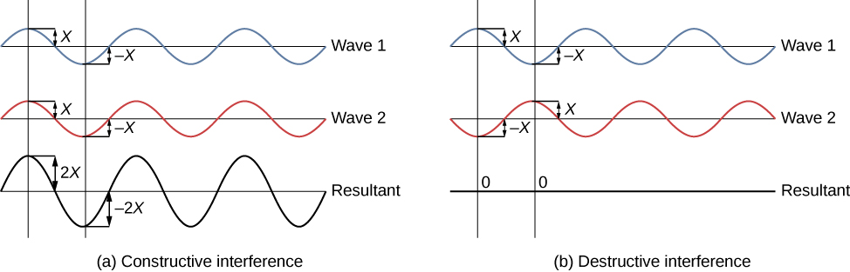
Fully Focused SAR (FF-SAR) altimetry
If the phase of wave 2 is not compensated:
FF-SAR waveforms are obtained by compensating for the range (as in Delay-Doppler) and phase migrations with respect to the scatterer’s position.
Requires the coherency of the transmitted pulses during the target illumination time (2 s).
In the Delay-Doppler the coherency is preserved only within each burst (3.5 ms) but not from burst to burst.
If the phase of wave 2 is compensated:
Credit: wikipedia

Slide 22
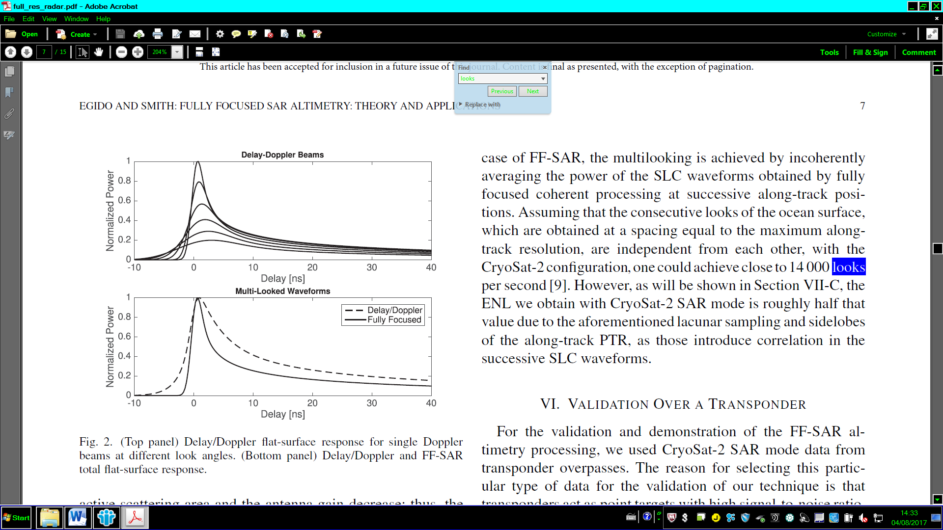
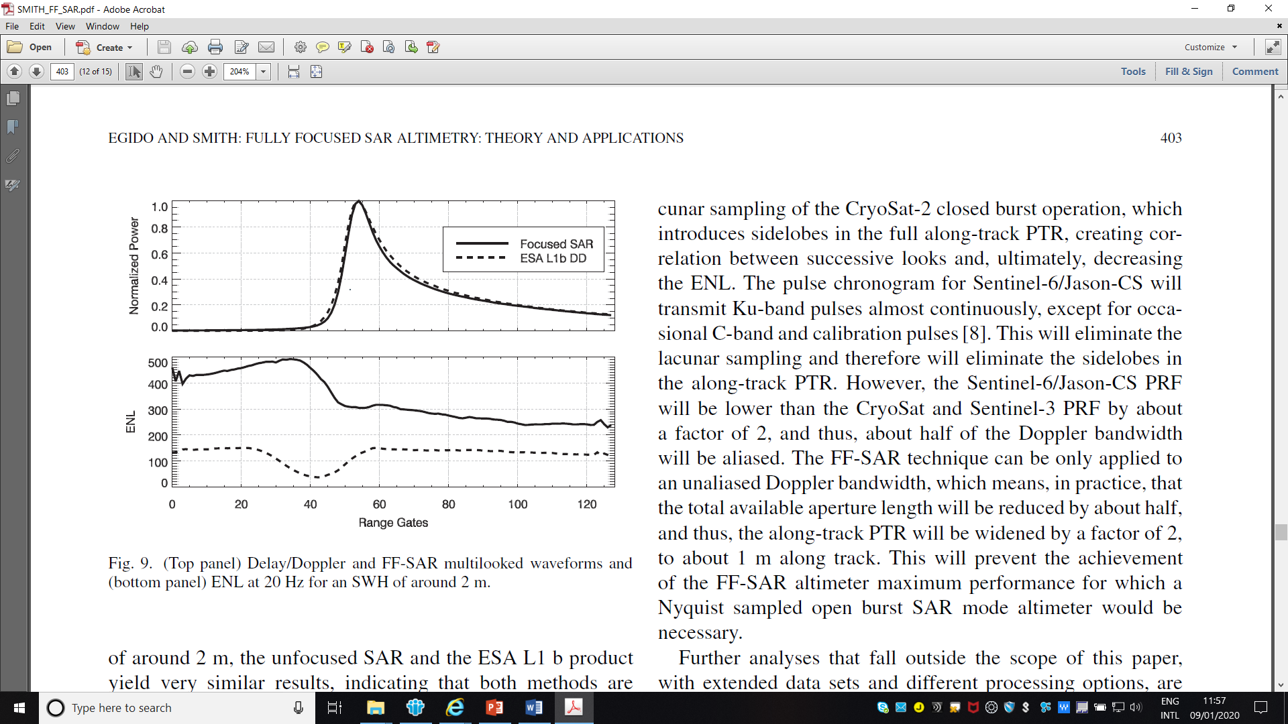
Fully Focused SAR (FF-SAR) altimetry
By applying the FF-SAR processing to a completely coherent target, the along-track resolution reaches its maximum -> 0.5 m with 1 statistical independent look in each along-track cell, NO STACK).
The increase of the number of looks multi-looked allows for a greater noise reduction in the estimation of geophysical parameters with respect to delay/Doppler.
However, by increasing the number of looks (ENL) in the multi-looking, the along-track cell size increases (>0.5 m).
Credit: Egido and Smith (2017)

Slide 23
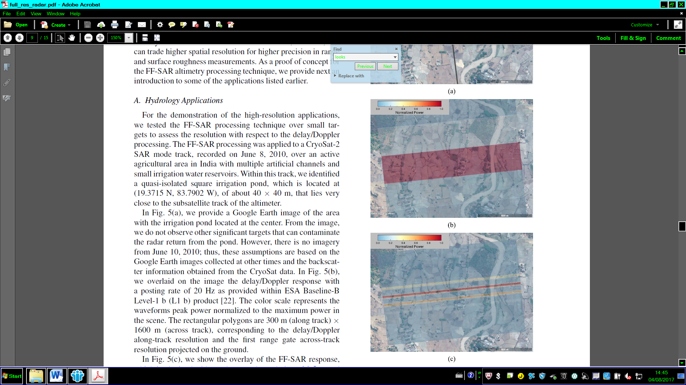
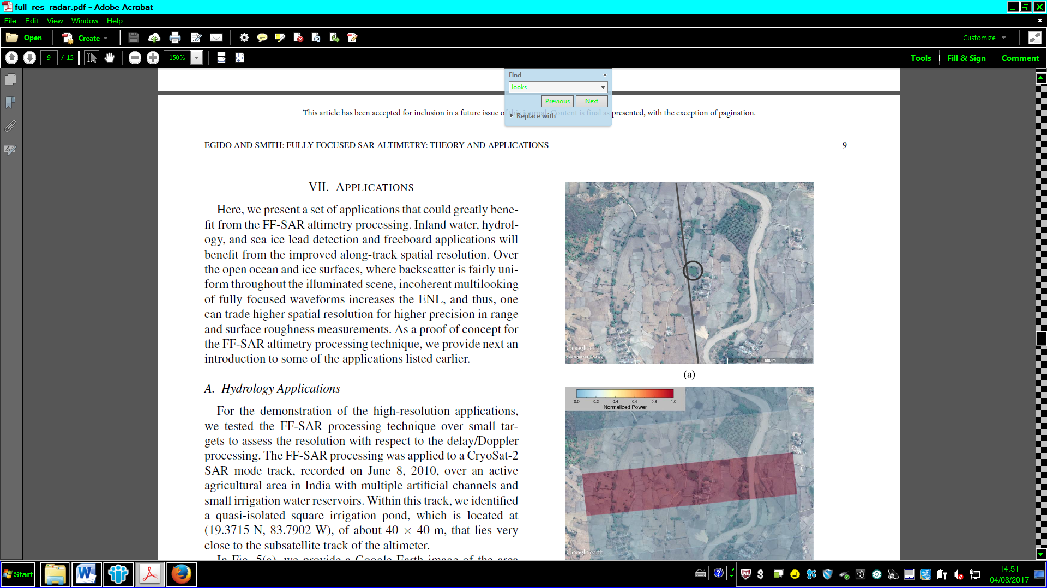
SAR vs FF-SAR Along-Track Resolution
SAR
FF- SAR
Credit: Egido and Smith (2017)

Slide 24
Unfocused & Fully-Focused SAR Retracking

Slide 25
SAR Retracking
As pointed out by Brown (1977), Raney (1998) and Egido and Smith (2017), the surface response (L1B waveform) is different for the 3 altimeter operative modes (LRM, Delay/Doppler SAR, Fully Focused SAR).
Therefore, no single model is suitable for all systems and scenarios of interest.
Credits: Rosmorduc et al. (2011)Egido and Smith (2017)

Slide 26
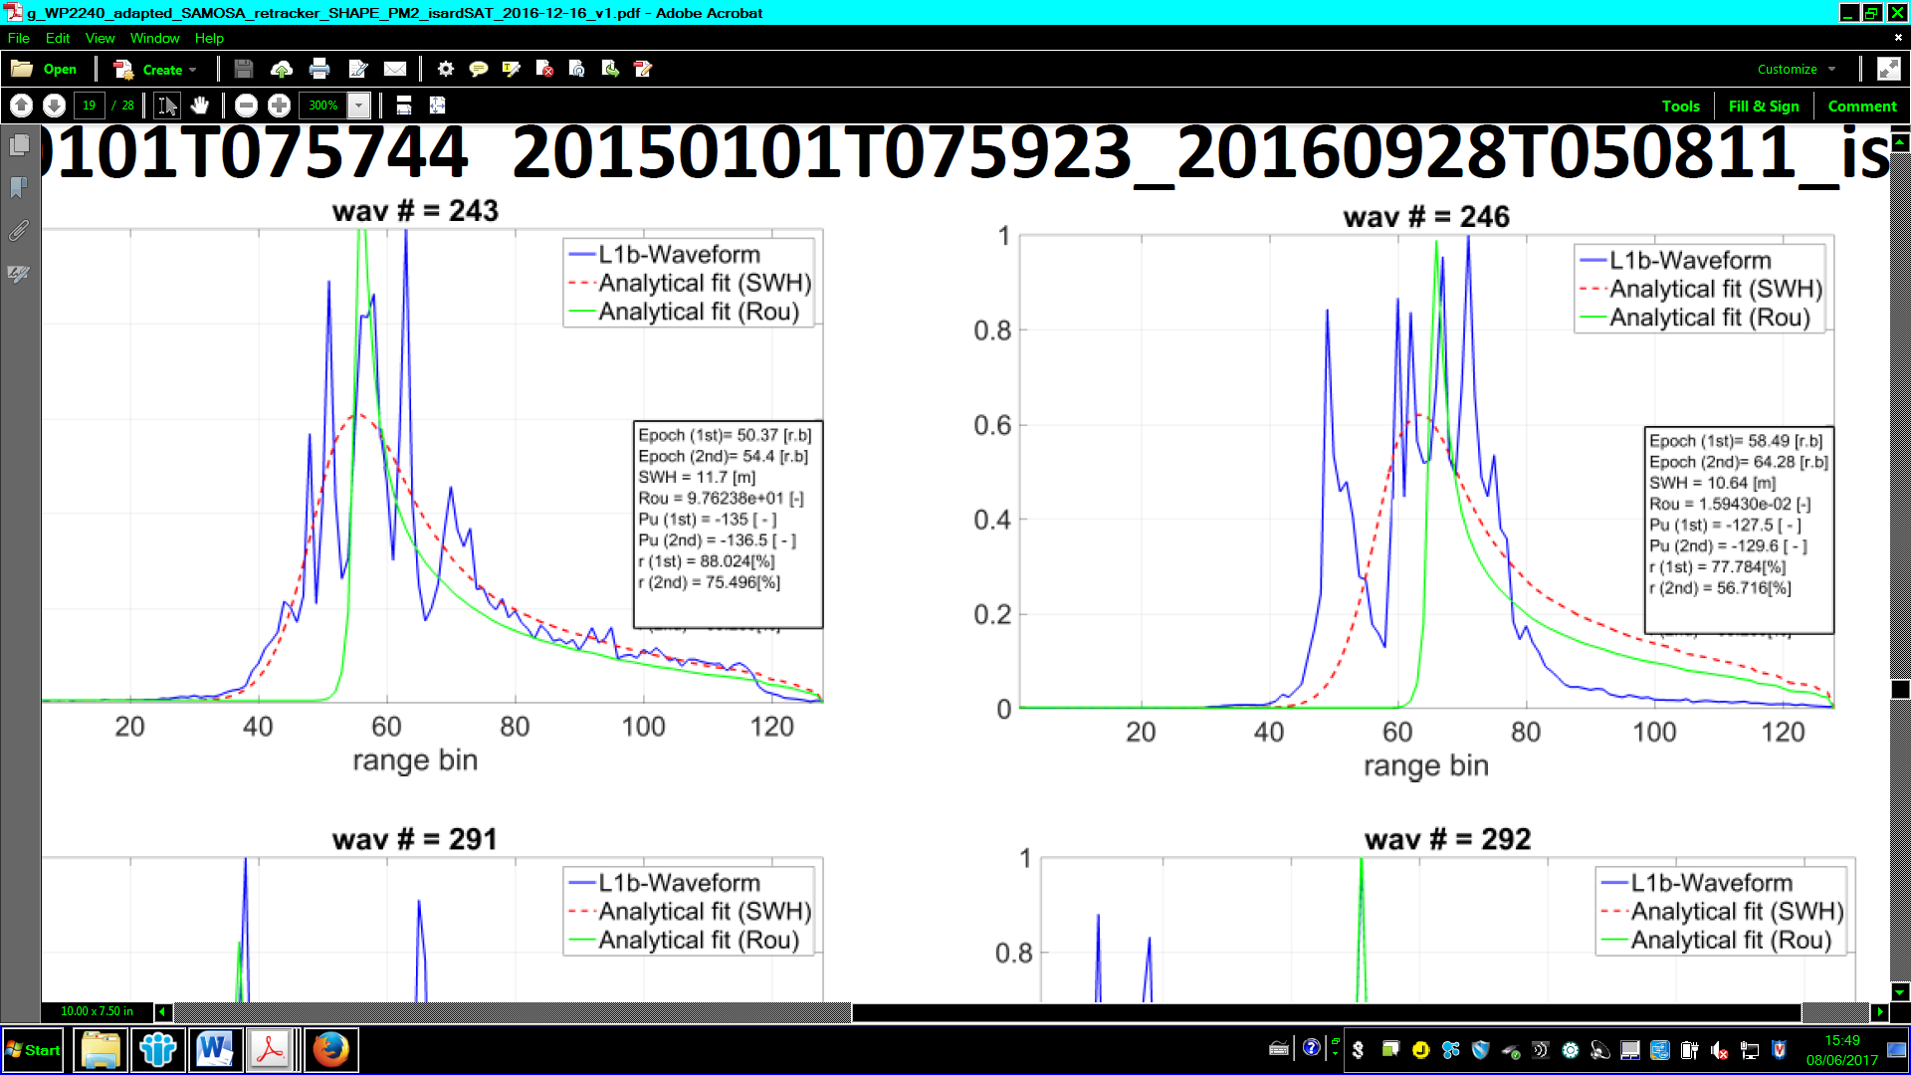
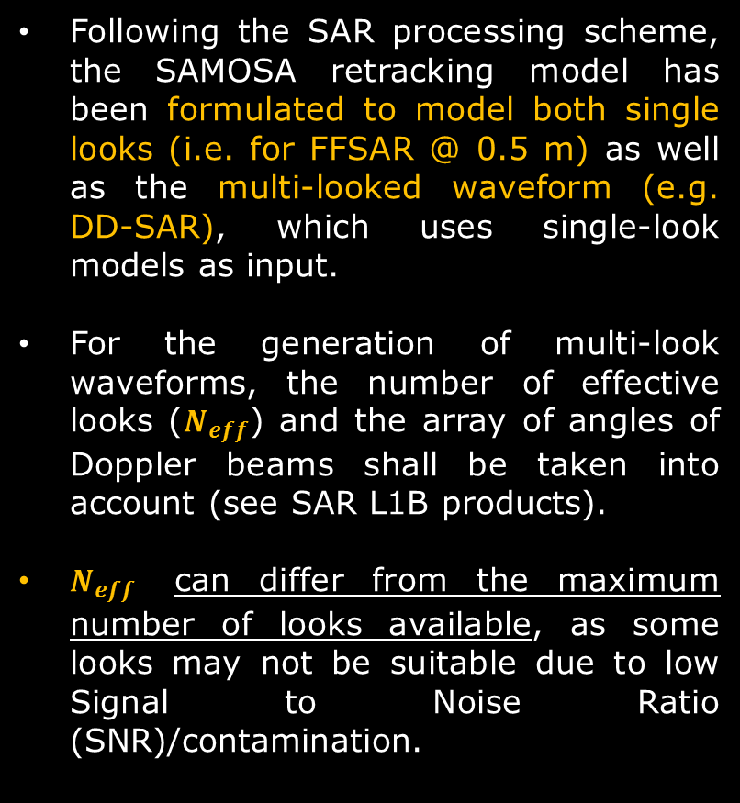
SAR Retracking
Following the SAR processing scheme, the SAMOSA retracking model has been formulated to model both single looks (i.e. for FFSAR @ 0.5 m) as well as the multi-looked waveform (e.g. DD-SAR), which uses single-look models as input.
For the generation of multi-look waveforms, the number of effective looks ($N_{eff}$) and the array of angles of Doppler beams shall be taken into account (see SAR L1B products).
$N_{eff}$ can differ from the maximum number of looks available, as some looks may not be suitable due to low Signal to Noise Ratio (SNR)/contamination.
Credit: ESA SCOOP Project

Slide 27
Subwaveform Retracking & Pseudo LRM

Slide 28
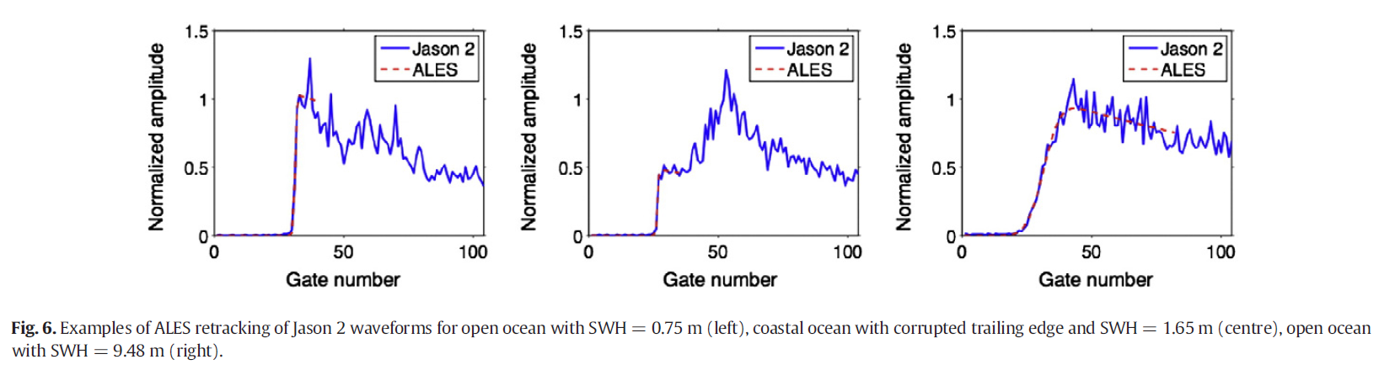
ALES (Adaptive Leading Edge Subwaveform retracker)
Leading-edge only retracker.
Applicable to all the pulse-limited altimetry missions & now also to SAR mission (Baltic+ SEAL Project).
Aims at retracking both open ocean and coastal data with the same accuracy using just one algorithm.
Selects part of each returned echo and models it with a classic “open ocean” Brown functional form.
By avoiding echoes from bright targets along the trailing edge, it is capable of retrieving more coastal waveforms than the standard processing.
Credit: Passaro et. al, 2014.

Slide 29
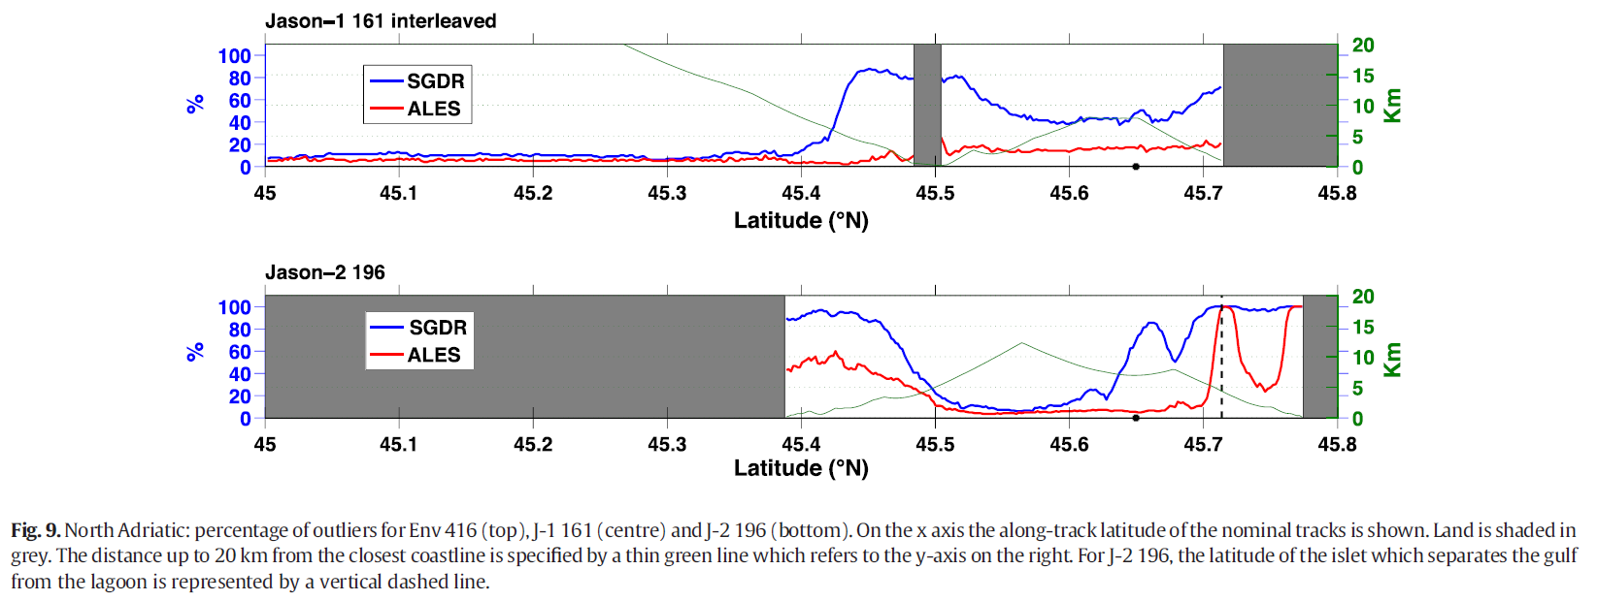
ALES (Adaptive Leading Edge Subwaveform retracker)
By avoiding echoes from bright targets along the trailing edge, it is capable of retrieving more coastal waveforms than the standard processing.
Credit: Passaro et. al, 2014.

Slide 30
The Coastal Zone

Slide 31
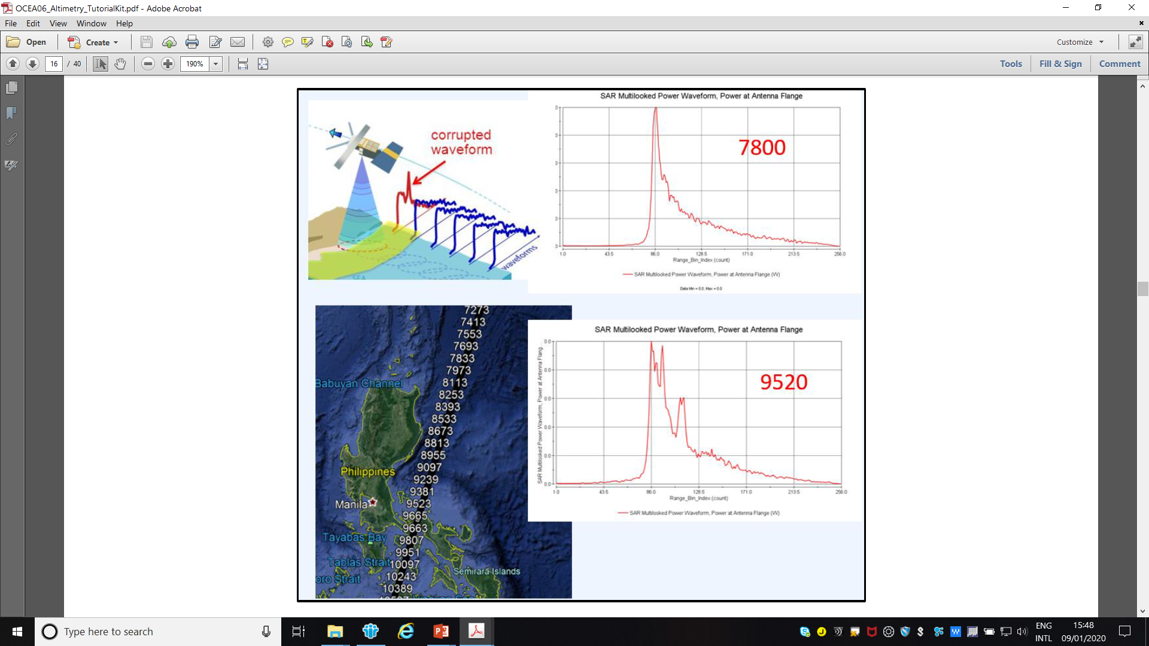
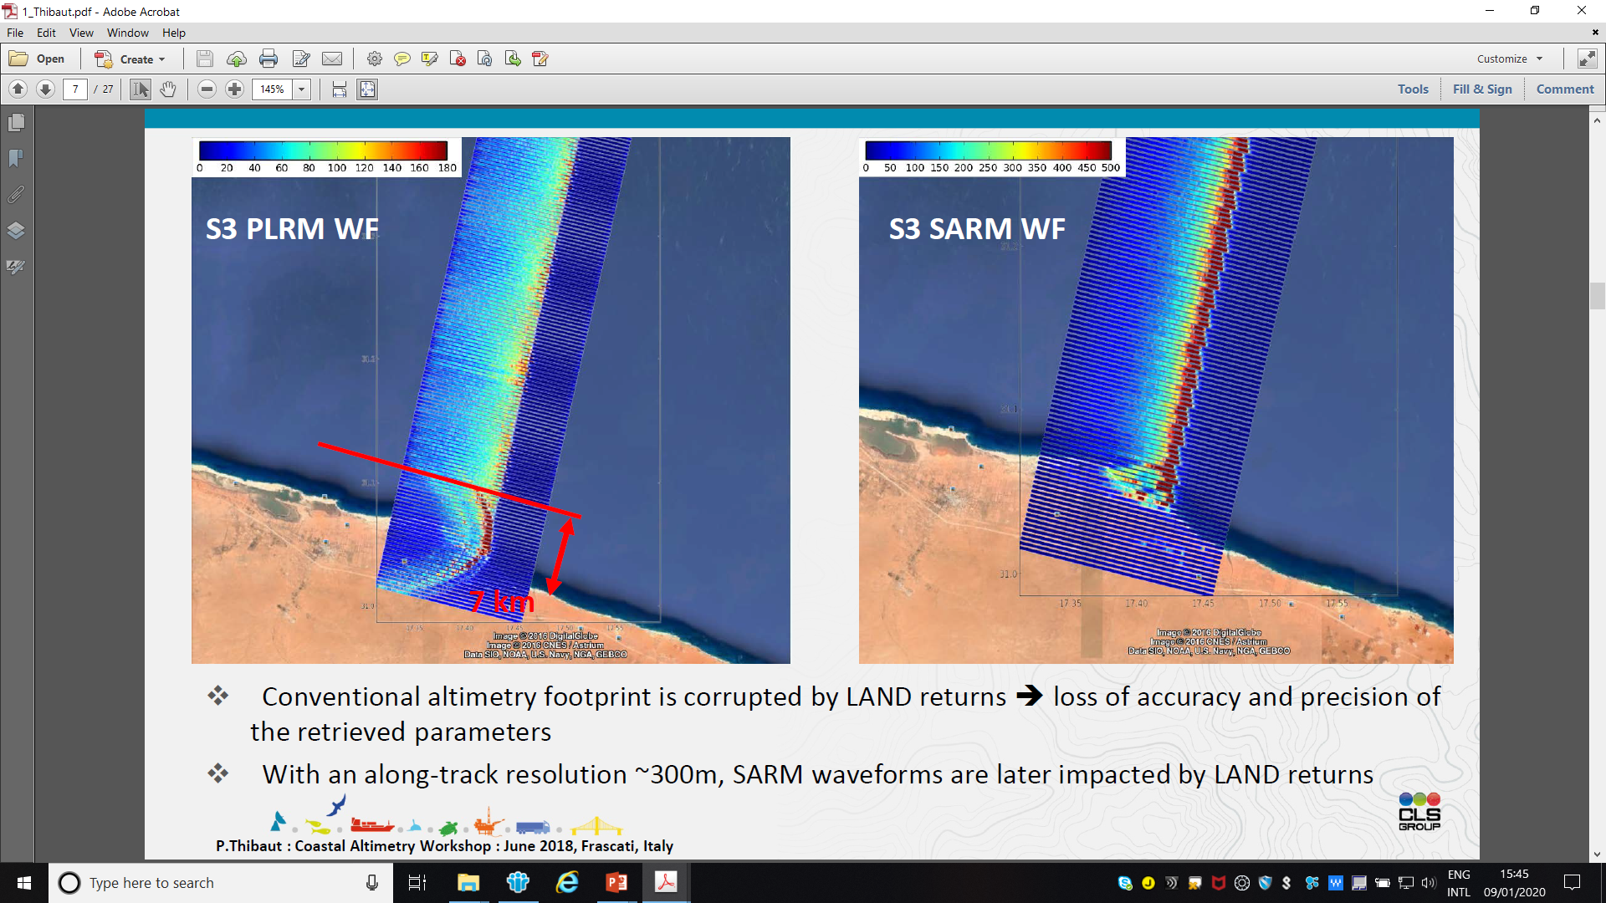
The Coastal Zone –L1b waveform contamination

Slide 32
On-board tracking mode (CLOSED vs OPEN LOOP)
Needed to modify the position of its tracking window and follow the ground topography.
Automatically performed on board in “closed-loop” mode by centering the received signal in the window using the information from past echoes.
Whenever there is some topography variation, there is no way to control which surface on the ground will be observed by the instrument in the closed-loop tracking mode.
The signal is often lost and a “search mode” is triggered.
Credit: Biancamaria et al. (2017)

Slide 33
On-board tracking mode (CLOSED vs OPEN LOOP)
To overcome this issue, a new tracking mode, the Doris Immediate Orbit on board DEtermination/Digital Elevation Model (DIODE/DEM) mode, has been implemented.
In this case, the satellite/ground range is not estimated automatically from formerly measured signal, but using a DEM stored on board
Credit: Biancamaria et al. (2017)

Slide 34
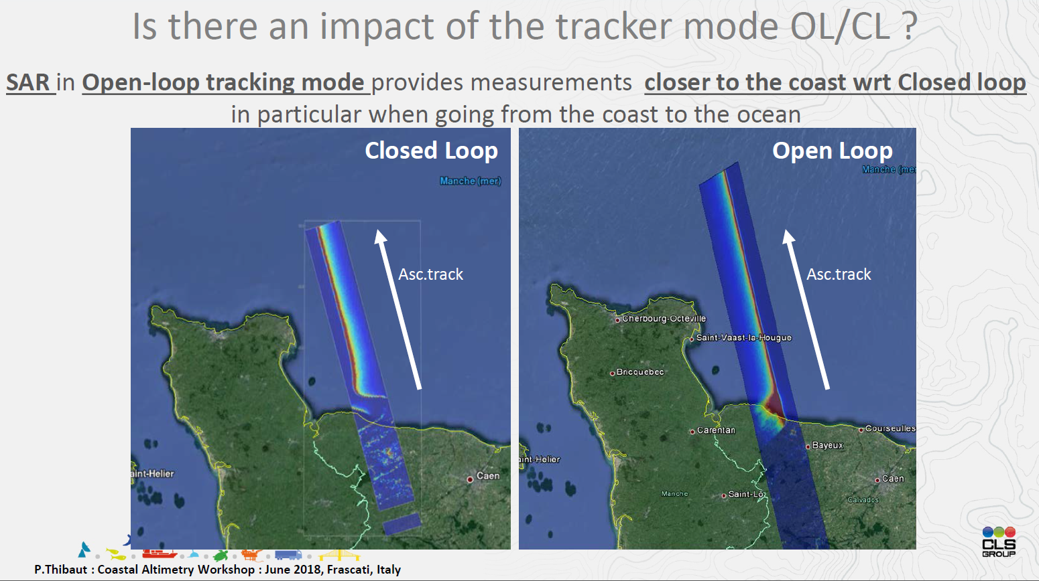
On-board tracking mode (CLOSED vs OPEN LOOP)
Over oceans, the performance is equivalent to the autonomous tracking mode, with an obvious improvement in coastal areas for land-to-water transitions.

Slide 35
The Analysis of the Estimates

Slide 36
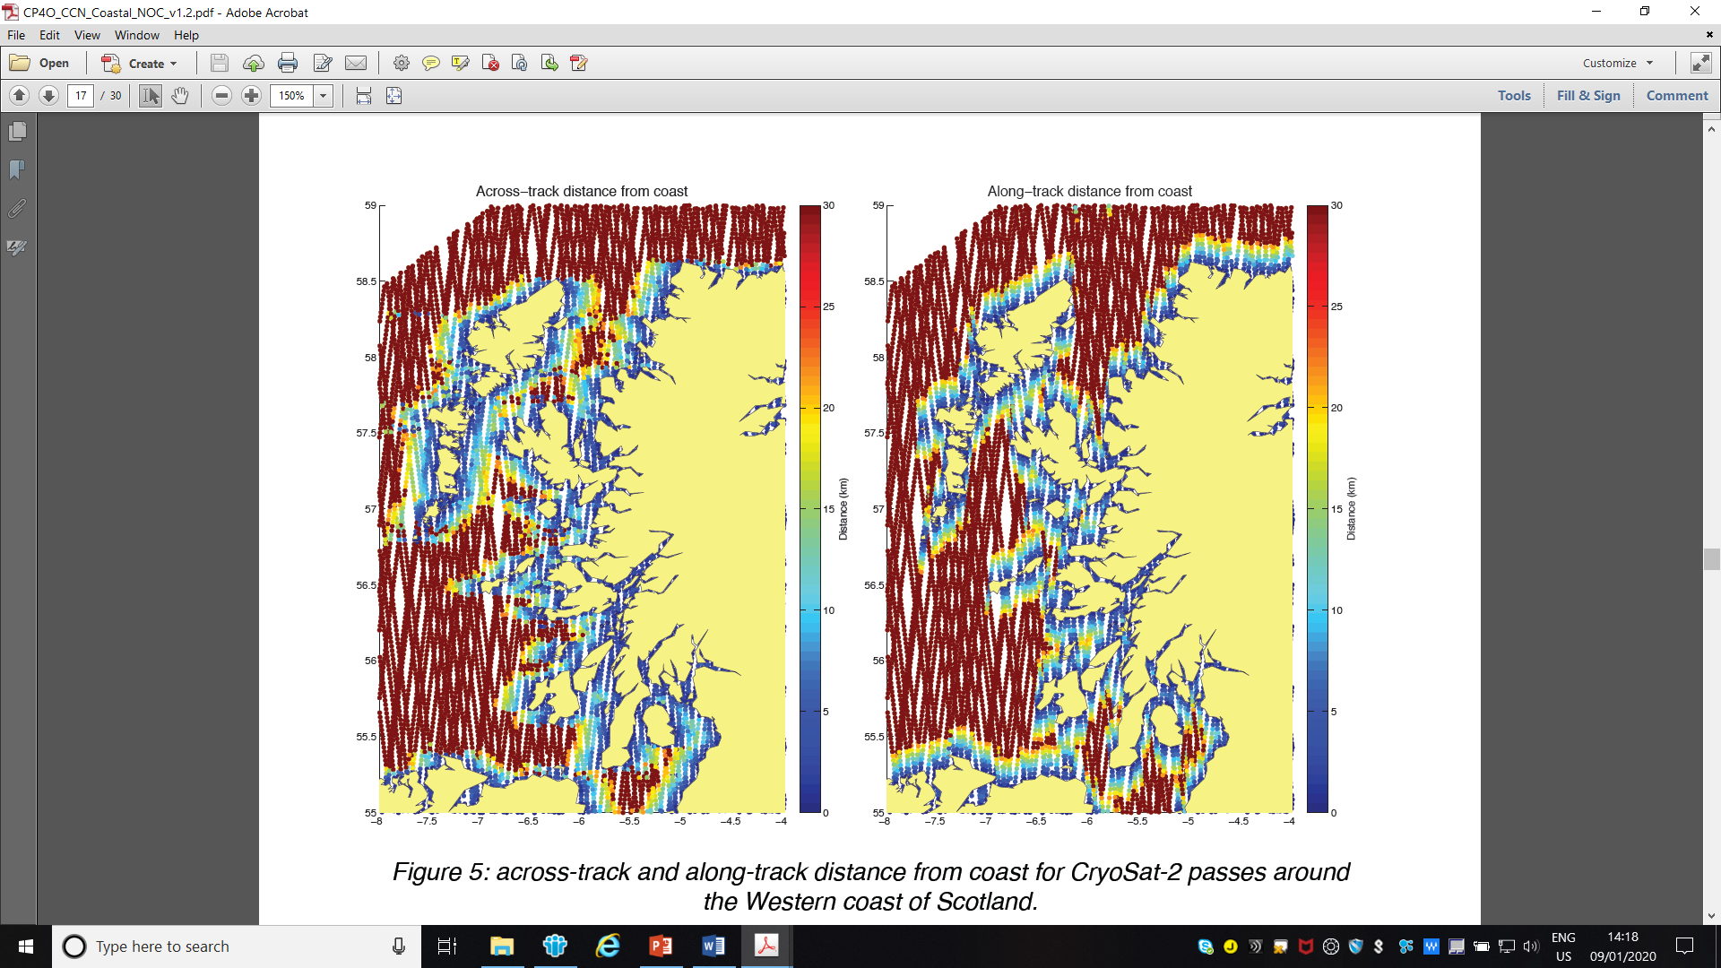
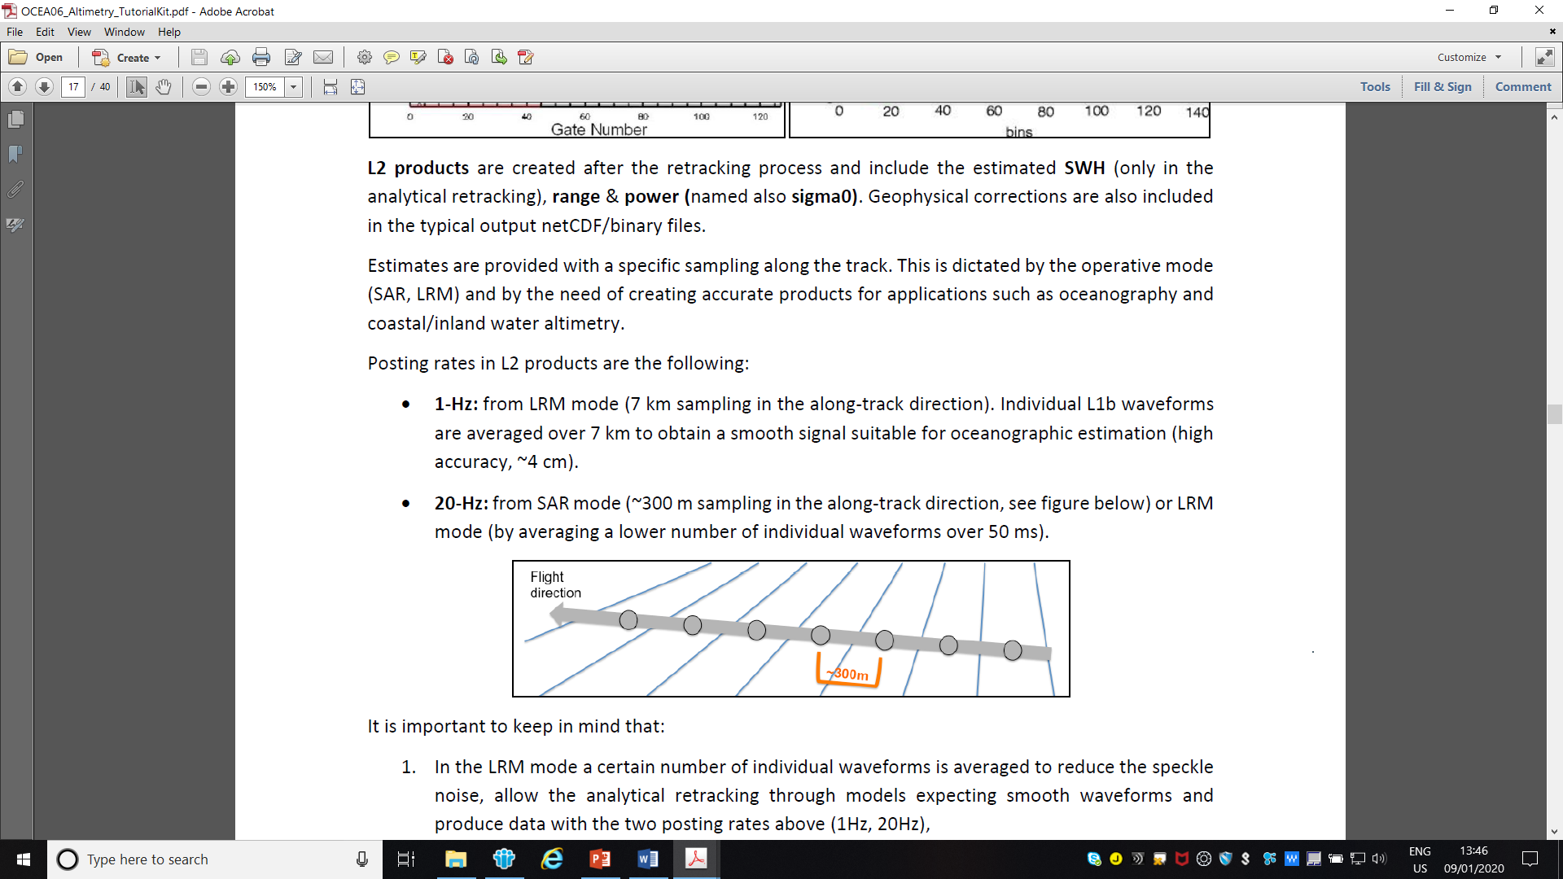
Analysis of the estimates
Precision Assessment calls for a verification of the data – i.e. an assessment of the repeatability of the measurement depending essentially on instrumental noise.
Accuracy assessment calls for a validation to be carried out against independent measurements such as those provided by tide gauges, to check for the existence of biases or trends.
Dependence of the results on both the coastal morphology and the relative orientation of the sub-satellite track versus the coastline.
Credit: ESA CP4O/CCN1 project

Slide 37
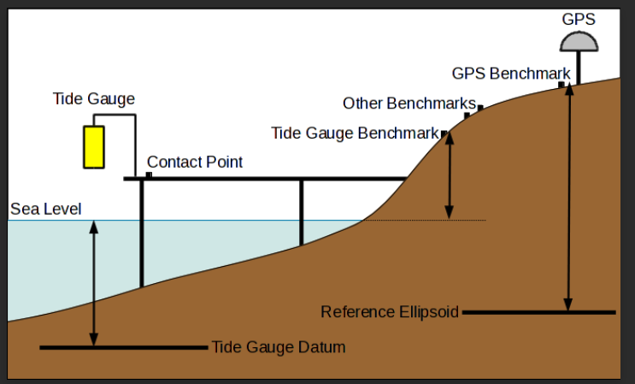
Tide Gauges
An accuracy assessment calls for a validation to be carried out against independent measurements such as those provided by tide gauges, to check for the existence of biases or trends.
Gauges locally measure relative sea level, absolute sea level if they are referenced to an ellipsoid (e.g. WGS84) with a GPS.
Tide gauge measurements (e.g. every 1 hour) are made with respect to a local fixed reference level on land.
Local vertical land motion can be corrected by using GPS data or glacial isostatic adjustment (GIA) models.
When reference datums are different, a de-meaning (subtracting the mean from each set of observations so that they are zero--mean) shall be applied when comparing TG and Altimeter dataset after filtering out outliers.

Slide 38
Tide Gauges
The total sea level TWLE inclusive of ocean tides and atmospheric forcing (due to pressure and wind effects) is typically considered.
This quantity is immediately comparable with the level recorded by a tide gauge (Newhaven tide gauge is located east of Brighton in the “Brighton Box”).
TWLE = Orbit Altitude - Corrected Range - Mean Sea Surface +
- (Solid Earth Tide + Load Tide)
Credit: ESA SLCCI & CP4O/CCN1 project

Slide 39
Summary
LRM Altimetry presents limitations in terms of resolution (SWH-dependency) & power exploitation.
SAR Altimetry allows, in its two forms (Unfocused & Fully-Focused), to overcome such limitations also allowing to produce pLRM waveforms.
As LRM and SAR waveforms are different, specific retrackers have to be developed. Retrackers are also scenario-dependent.
Waveform contamination is a key issue in coastal altimetry. ALES Sub-waveform and SAMOSA+ retrackers allow to obtain more valid estimates close to the coast.
Coastal altimetry has benefited from the Open Loop tracking mode.
Tide gauges, buoys and models provide validation data to infer the quality of altimetry processors and retrackers.
Credit: ESA SLCCI & CP4O/CCN1 project

